Slide 1

FAKE NEWS CLASSIFIER
A STUDY ON IDENTIFYING FAKE NEWS
KARTHIKEYA RALLAPALLI
SAI KIRAN AKARAPU
VENKATA SIVA VATTIKONDA

Slide 2

INTRODUCTION
Project Objective:
Develop a machine learning classifier to distinguish between real and fake news articles.
Importance of the Problem:
Fake news can mislead the public, influence opinions, and cause social unrest.
Reliable detection systems are essential for maintaining information integrity.

Slide 3
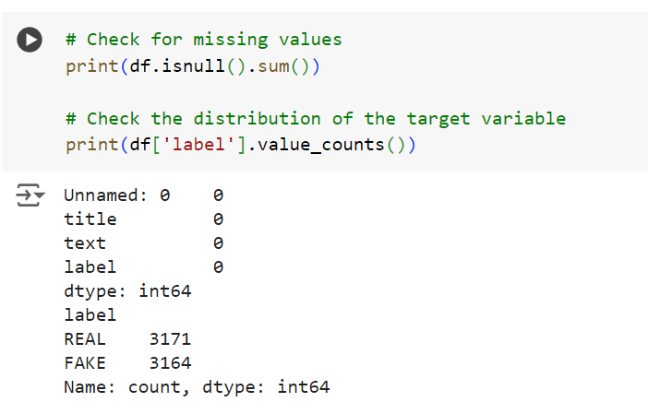
DATASET OVERVIEW
Dataset Source:
The dataset consists of news articles labeled as fake or real.
Dataset Description:
Number of Records: 20,000 articles.
Features: Title, text, label (0 for fake, 1 for real).
Class Distribution: Approximately balanced between fake and real news.
There are no missing values in our dataset as we can see from the snapshot.

Slide 4

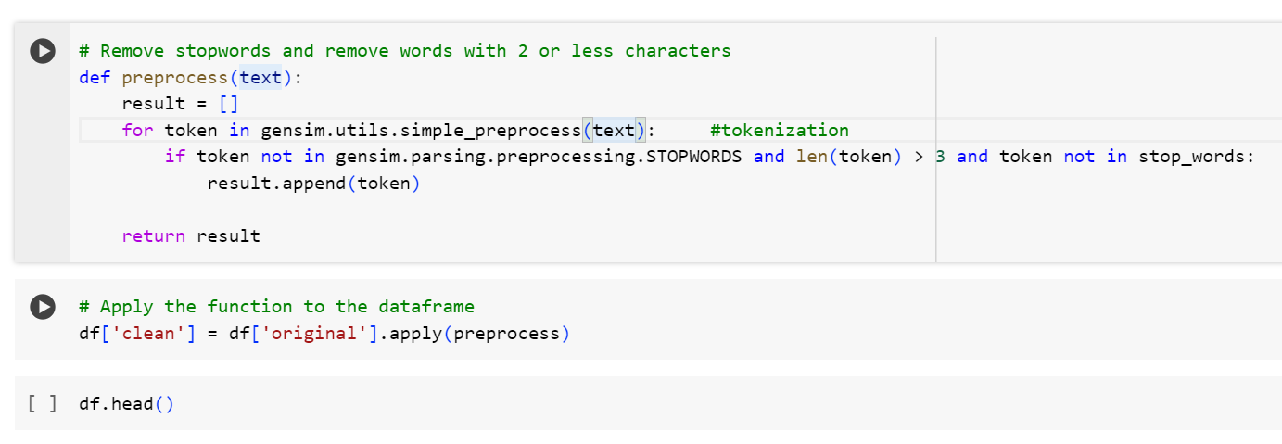
Data Preprocessing
Combining Title and Text:
Created a new column called 'original' by merging title and text.
Rationale: We combined the title and the main text of each article into one big piece of text to give more context to our tool.
Text Preprocessing:
Used Gensim for tokenization and stop words removal.
The simple preprocess function from Gensim:
Converts the text to lowercase.
Tokenizes the text into individual words.
Removes punctuation.
Optionally removes words that are too short or too long
Created 'clean' column with preprocessed text.
Creating Clean Joined Column:
Joined lists of cleaned words into single strings.
Created 'clean_joined' column.
Why Not Other Methods?
Gensim is efficient for initial preprocessing.
Ensures consistency in text data for better feature extraction.

Slide 5
Why are we combining title and text together?
The title often summarizes the main idea or the most important aspect of the article, while the text provides detailed information. Combining both can give a more complete picture of the content.
Augmenting Short Articles: For very short articles, the title can provide additional context and information that might not be present in the body text alone.
Use in the project: Fake news articles often have sensational titles that may not match the content. Combining the title and text helps the model to detect such inconsistencies.

Slide 6
What are stop words and why should we remove them?
Stop words are a set of commonly used words in a language. Examples of stop words in English are “a,” “the,” “is,” “are,” etc.
We must remove the words which carry little to no useful information at all from our dataset.
This can be done by maintaining a list of stop words (which can be manually or automatically curated) and preventing all words from your stop word list from being analyzed.
Stop words helps us reduce noise, increase efficiency and enhance model performance by reducing dimensionality.
In tasks such as document similarity or clustering, stop words can introduce noise that affects the accuracy of similarity measures. Removing stop words leads to more accurate and meaningful similarity calculations.

Slide 7
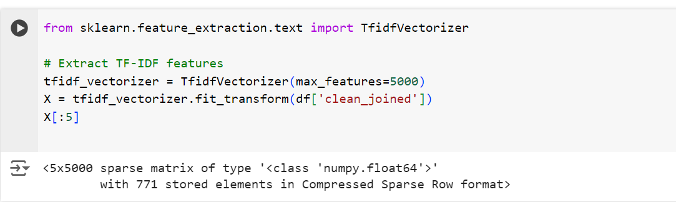
FEATURE EXTRACTION
Converting Text to Numbers
Why Convert to Numbers?
Computers understand numbers better than text. So, we convert our cleaned text into a form that the computer can understand and analyze.
How We Do It:
We use a method called TF-IDF (Term Frequency-Inverse Document Frequency). It’s like assigning scores to words based on how important they are in the text.
Why Not Other Methods?
TF-IDF effectively highlights important words while reducing the impact of common but less informative words.

Slide 8

TFIDF Transformer and how it is implemented?
List of Words:
By generating a list of all words, we can perform frequency analysis to identify commonly occurring words that might not be informative for our classification task. These frequent but non-discriminative words can be added to our stop words list to improve the quality of your text data.
We can do the frequency of word calculations and everything with either Count Vectorizer or TFIDF Transformer.
Lists of cleaned words are then converted into single strings in a new column 'clean_joined' in our Data Frame.
This transformation is often necessary for further text processing tasks like vectorization or modeling, where each document (in this case, a news article) needs to be represented as a single string of text. This process ensures that your data is in a format suitable for subsequent NLP tasks.

Slide 9
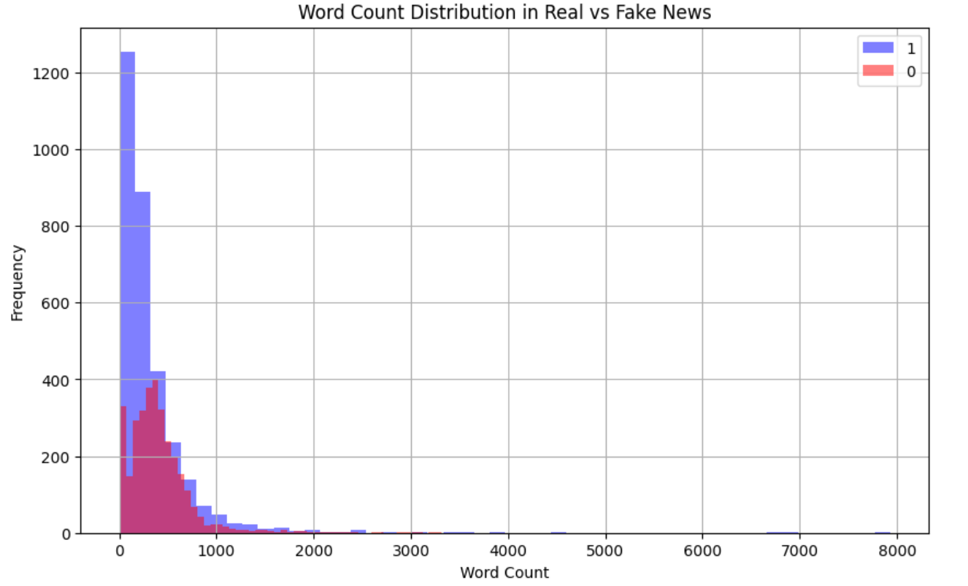
Data Visualization
Word Count Distribution
Sentiment PolarityAnalysis

Slide 10
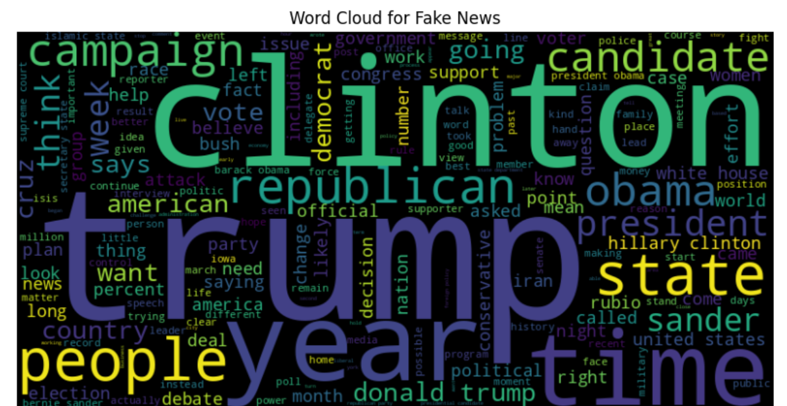
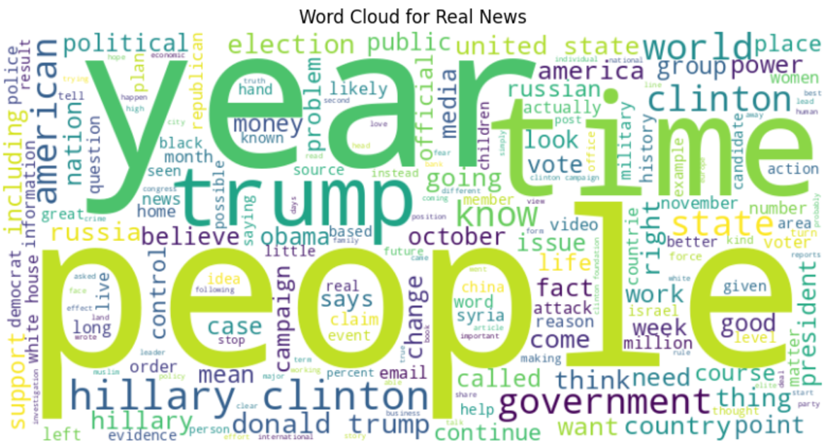
WORD CLOUDS

Slide 11
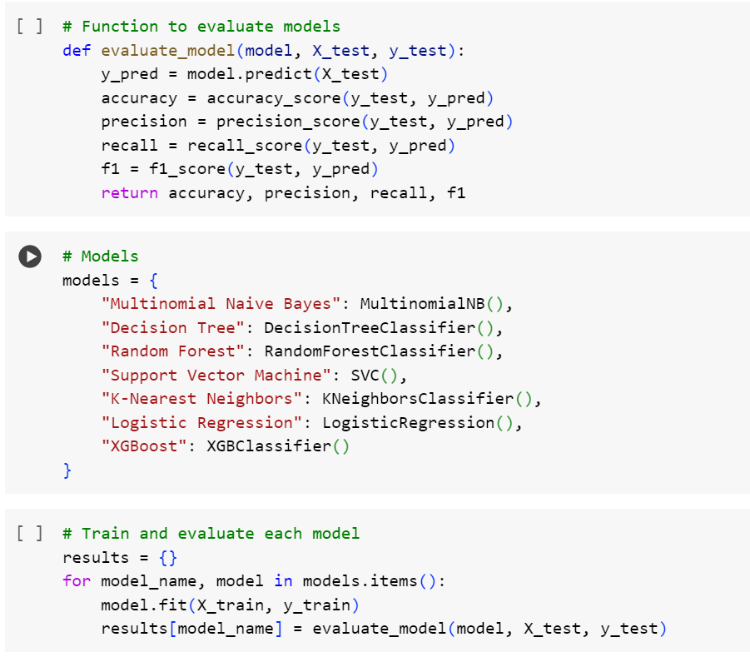
MODEL BUILDING
What’s a Classifier:
A classifier is a type of program that can categorize things. In our case, it categorizes news articles as fake or real.
Types of Classifiers We Tried:
Multinomial Naive Bayes: Simple and fast. Good for text data.
Decision Tree: Makes decisions based on features (important words).
Random Forest: Uses many decision trees to improve accuracy.
Support Vector Machine (SVM): Good for handling a lot of words.
K-Nearest Neighbors (KNN): Looks at the nearest neighbors (similar articles).
Logistic Regression: Predicts probabilities for two outcomes (fake or real).
XGBoost: Very powerful and efficient, often used in competitions.
Choosing the Best One:
After testing all of them, we found that XGBoost worked the best in terms of accuracy.

Slide 12
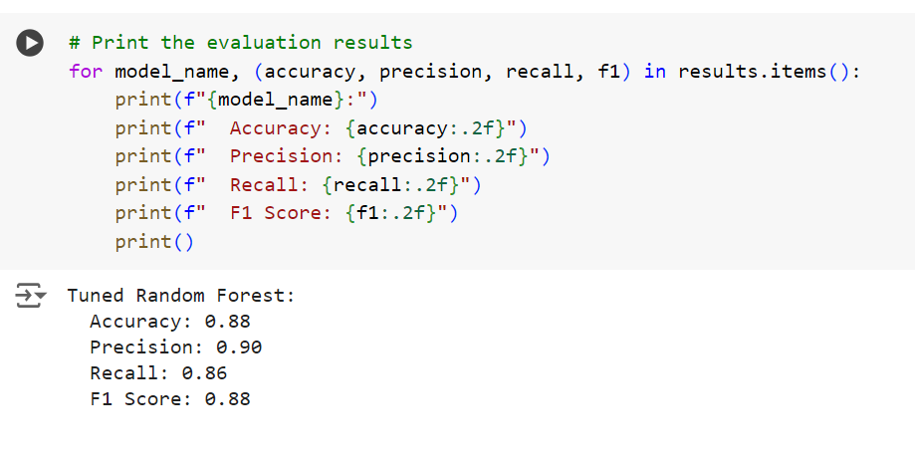
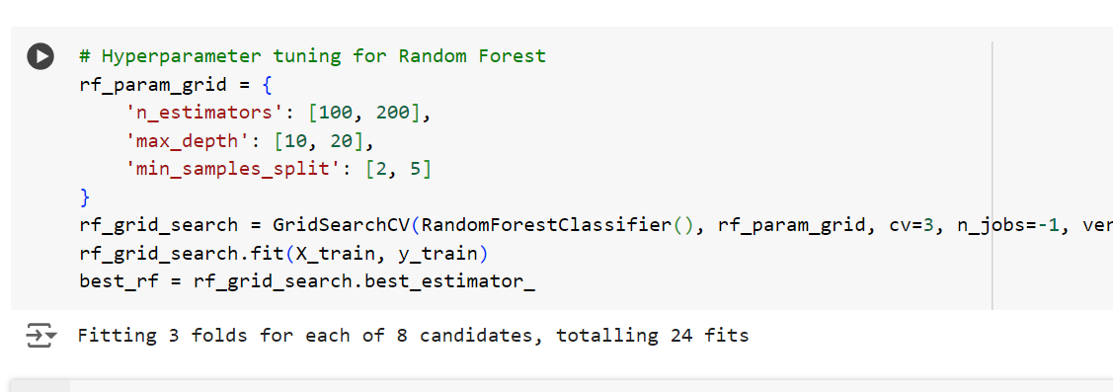
WE ALSO TRIED HYPERPARAMETER TUNING BUT…
We tried hyperparameter tuning to improve the accuracy, but the accuracy is further depleting instead of increasing which is a possible sign of overfitting. Hence, we ignored that part.
The screenshots of the trails are attached below for reference:

Slide 13
RESULTS AND SUMMARY
Multinomial Naive Bayes: Accuracy: 0.88, Precision: 0.90, Recall: 0.86, F1 Score: 0.88
Decision Tree: Accuracy: 0.80, Precision: 0.80, Recall: 0.81, F1 Score: 0.80
Random Forest: Accuracy: 0.91, Precision: 0.90, Recall: 0.91, F1 Score: 0.91
Support Vector Machine: Accuracy: 0.92, Precision: 0.94, Recall: 0.90, F1 Score: 0.92
K-Nearest Neighbors: Accuracy: 0.87, Precision: 0.85, Recall: 0.89, F1 Score: 0.87
Logistic Regression: Accuracy: 0.91, Precision: 0.92, Recall: 0.90, F1 Score: 0.91
XGBoost: Accuracy: 0.93, Precision: 0.93, Recall: 0.92, F1 Score: 0.93
Out of all the models above, XG Boost gives the highest accuracy with the perfect mix of remaining parameters. Besides, the misclassified labels are also very low. So, we decided to deploy that model.

Slide 14
THANK YOU

